Slide 1
From Communication to Consulting
My Unexpected Career Journey
Matt Schermerhorn ‘09

Slide 2
Agenda
1. Take Me Back to UCSB!
2. Graduating in a Recession – First Job
3. Following my Dreams! – Career in Sport
4. It Was All a Dream – Career Pivot
5. Time for Upgrades – Upping my Skillset
6. Communication to Consulting – Today

Slide 3
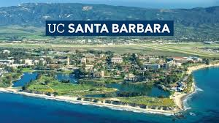
Take Me Back to UCSB!
Sample Courses/ Internships/ Skills
Communication Law
Advertising Literacy
Sport Communication
Interpersonal Communication
Sport Management
Rec Sports Marketing Internship

Slide 4
Graduating in a Recession – First Job
Didn’t know where to begin
Applied for everything
Not understanding what my network was or who was in it
No idea what a Technical Recruiter even is or does – First Job

Slide 5
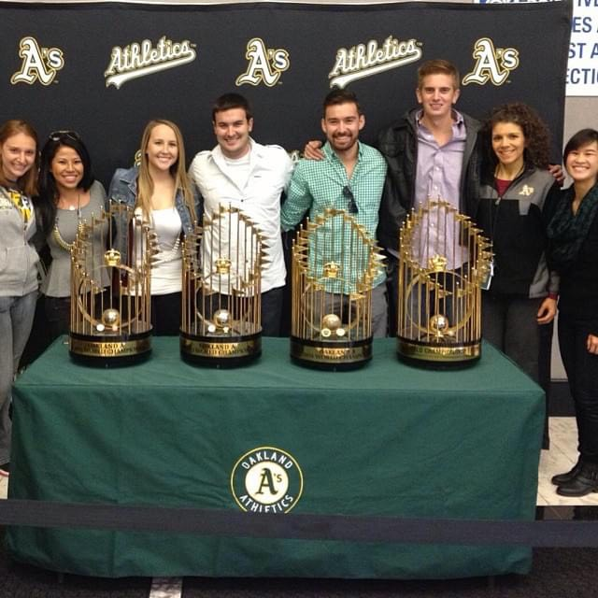
Following My Dreams! – Career in Sport
Promotional marketing & special events
Fan and community engagement
Learning how to listen
Develop different communication styles

Slide 6
It Was All a Dream – Career Pivot
Finding the unforeseen opportunities
Staying the course
Focus shifted to new goals
Family
Buying Home
Privacy

Slide 7
Time for Upgrades – Upping My Skillset
Soft Skill Development
Communication Dynamics
Teamwork/Leadership
Problem-solving/Critical Thinking
Adaptability
Interpersonal
Need to focus on … Hard Skill Development
The Why?
The How?
The What?
Technical Systems/Tools
Statistical Analysis
Strategic Development

Slide 8
From Communication to Consulting – Today
The journey is almost as good as the real thing
What does an Implementation Consultant actually do?

